Slide 1
ME111 Engineering Drawing
Module 2: Curves
Dr. S.N. Joshi (Division 1)
Dr. Ajay Kalamdhad (Division 2)
Dr. Nelson Muthu (Division 3)
Dr. Rajan Choudhary (Division 4)

Slide 2
PLANE CURVES
Designing certain objects require shapes made out of curves which satisfy specific mathematical equations to meet the functional, aesthetic and ergonomic requirement of the object.
Basic Construction skills
How to divide a line into given number of equal parts
How to divide a circle into given number of equal parts
How to find the center of an arc or a circle
How to draw a normal and a tangent to the arc/ circle
How to construct regular polygons
How to construct arc/ circle tangent to line(s)/ arc(s)

Slide 3
Loci of points
Loci of the point is the path taken by the point as it moves in space.
E.g.
If a point moves on a plane in such a way that it keeps its distance constant from a fixed straight line, the locus of the point is a straight line parallel to and at a distance equal to the given distance from the given fixed line.
If a point moves on a plane in such a way that it keeps its distance constant from a given fixed point, the locus is a circle with the given fixed point as the center and the radius equal to the distance from the fixed point.
If a point moves on a plane in such a way that it keeps its distance constant from a fixed circular arc, the locus of the point is a circular arc with the same center and a radius equal to the radius of the given arc plus or minus the fixed distance.

Slide 4
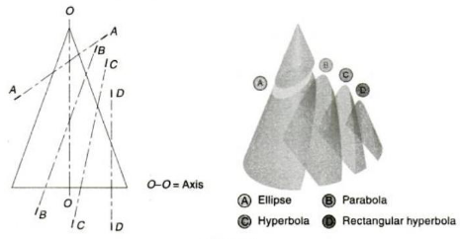
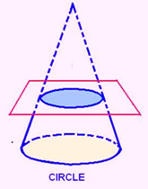
Conic sections (conics)
Curves formed by the intersection of a plane with a right circular cone. Right circular cone is a cone that has a circular base and the axis is inclined at 90⁰ to the base and passes through the center of the base.
Conic sections are always "smooth". More precisely, they never contain any inflection points.
Important for many applications, such as aerodynamics, civil engineering, mechanical engineering, etc.

Slide 5
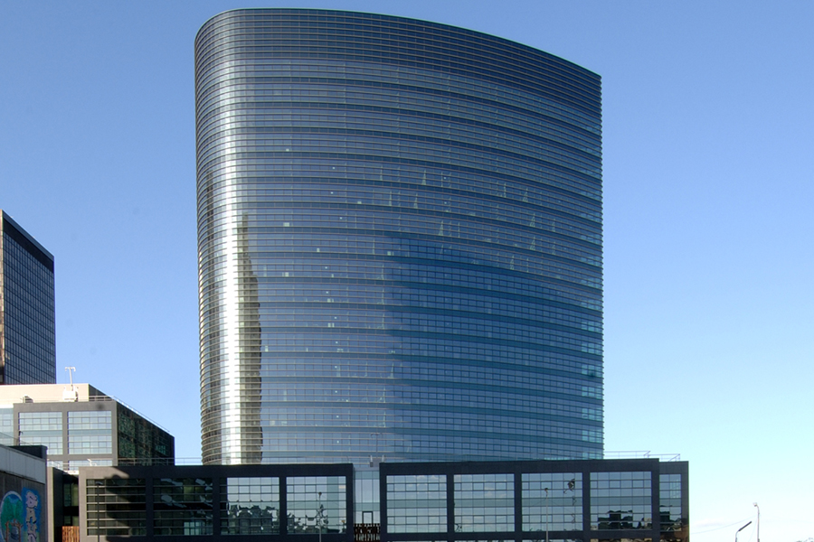
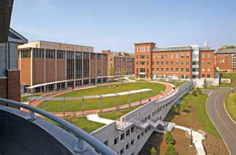
Elliptic structures
Ellipse structure
(http://www.agrealestate.eu)
Campus common (http://www.landscapeonline.com)

Slide 6
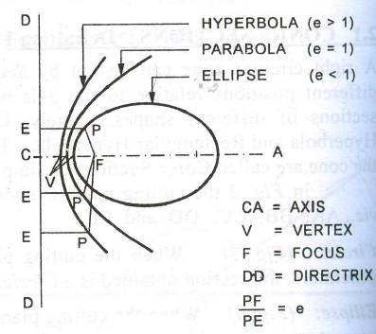
Conic
A conic is defined as the curve traced by the point moving in a plane such that the ratio of its distance from a fixed point and a fixed line is always constant. The fixed point is called the focus and the fixed line the directrix. The ratio is called the eccentricity (e)
Eccentricity (e) =
For Ellipse, e<1
For Parabola, e=1
For Hyperbola, e>1
Distance of a point from focus
Distance of a point from directrix

Slide 7
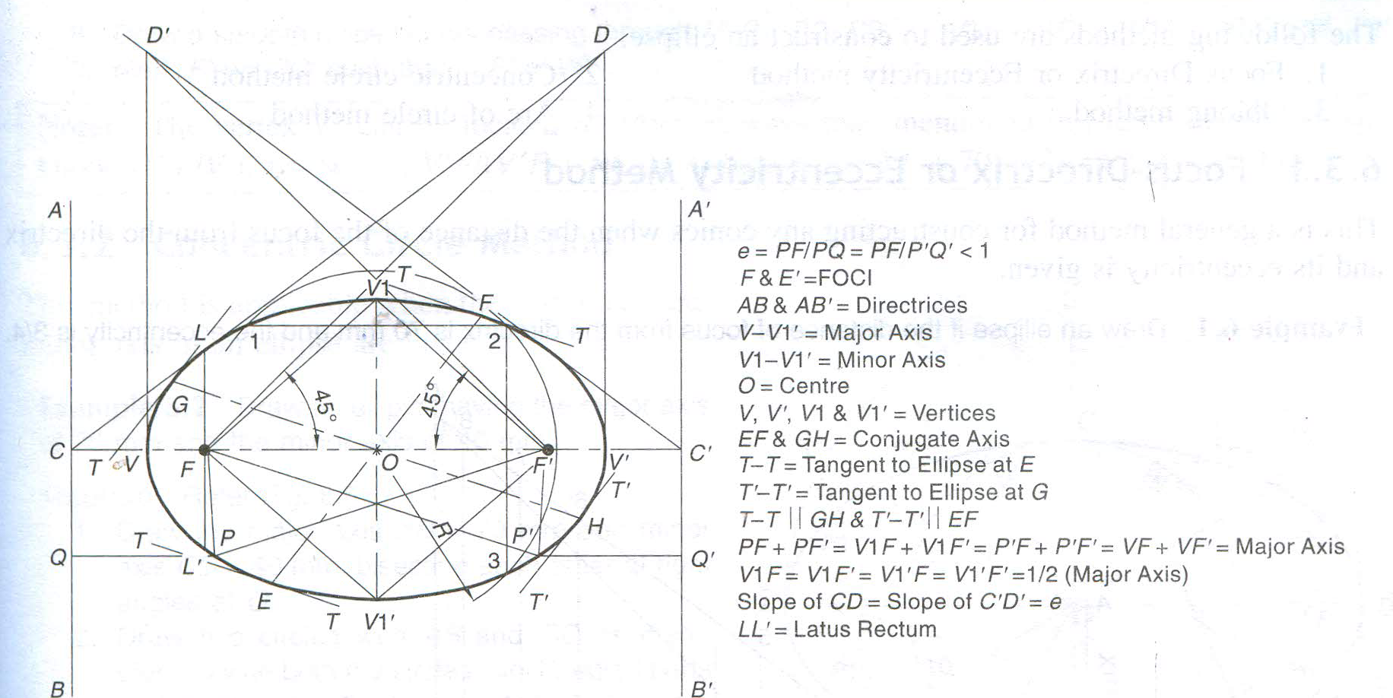
Ellipse
An ellipse is also defined as a curve traced by a point, moving in a plane such that the sum of its distances from two fixed points is always the same.
Terminologies
Elliptical curves applications:
Architectural, engineering design, arches, bridges, elliptical gears, bullet nose etc.

Slide 8
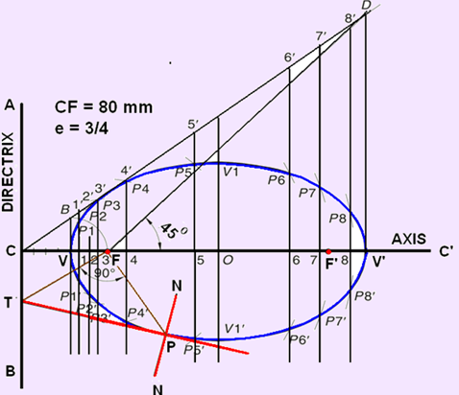
Generating an ellipse
Focus-Directrix Or Eccentricity Method
General method of constructing any conics when the distance of the focus from the directrix and its eccentricity are given.
Drawing an ellipse if the distance of focus from the directrix is 70 mm and the eccentricity is 3/4.
Draw the directrix AB & axis CC’
Mark F on CC’ such that CF = 70 mm.
Divide CF into 7 equal parts and mark V at the fourth division from C.
At V, erect a perpendicular VB = VF. Join CB. Through F, draw a line at 45° to meet CB produced at D. Through D, drop a perpendicular DV’ on CC’. Mark O at the midpoint of V– V’.

Slide 9
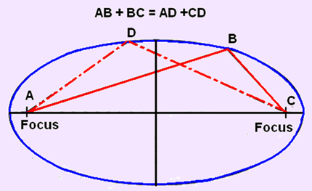
Generating an ellipse
Mark a few points, 1, 2, 3, … on V– V’ and erect perpendiculars though them meeting CD at 1’, 2’, 3’…. Also erect a perpendicular through O.
With F as a centre and radius = 1–1’, cut two arcs on the perpendicular through 1 to locate P1 and P1’. Similarly, with F as a centre and radii = 2–2’, 3–3’, etc., cut arcs on the corresponding perpendiculars to locate P2 and P2’, P3 and P3’, etc. Also, cut similar arcs on the perpendicular through O to locate V1 and V1’.
An ellipse is also the set of all points in a plane for which the sum of the distances from the two fixed points (the foci) in the plane is constant.

Slide 10
Generating an ellipse (Concentric circle method)
Draw ellipse by concentric circle method.
Take major axis 100 mm and minor axis 70 mm long.
3
2
4
C
Steps:
1. Draw both axes as perpendicular bisectors of each other & name their ends as shown.
2. Taking their intersecting point as a center, draw two concentric circles considering both as respective diameters.
3. Divide both circles in 12 equal parts & name as shown.
4. From all points of outer circle draw vertical lines downwards and upwards respectively.
5.From all points of inner circle draw horizontal lines to intersect those vertical lines.
6. Mark all intersecting points properly as those are the points on ellipse.
7. Join all these points along with the ends of both axes in smooth possible curve.
1
5
2
3
4
1
5
A
B
10
6
10
9
7
6
8
D
9
7
8
Used when major axis and minor axis
of an ellipse are given.

Slide 11
Generating an ellipse (Oblong - rectangular Method)
1 Draw a rectangle taking major and minor axes as sides.
2. In this rectangle draw both axes as perpendicular bisectors of each other..
3. For construction, select upper left part of rectangle. Divide vertical small side and horizontal long side into same number of equal parts.( here divided in four parts)
4. Now join all vertical points 1,2,3,4, to D. And all horizontal points i.e.1,2,3,4 to C.
5. Then extend C-1 line upto D-1 and mark that point. Similarly extend C-2, C-3, C-4 lines up to D-2, D-3, & D-4 lines.
7. Mark all these points properly and join all along with ends A and D in smooth possible curve. Do similar construction in right side along with lower half of the rectangle. Join all points in smooth curve for required ellipse.
Draw ellipse by Rectangle method.
Take major axis 100 mm and minor axis 70 mm long.
D
4
4
3
3
2
2
1
1
A
4
3
2
1
B
1
2
3
C
Used when major axis and minor axis
of an ellipse are given.

Slide 12
Generating an ellipse (Oblong – parallelogram Method)
Draw ellipse by Oblong method.
Draw a parallelogram of 100 mm and 70 mm long sides with included angle of 75^{0.}Inscribe Ellipse in it.
STEPS ARE SIMILAR TO
THE PREVIOUS CASE
(RECTANGLE METHOD)
ONLY IN PLACE OF RECTANGLE,
HERE IS A PARALLELOGRAM.
Used when the conjugate axes with the angle
between them is given.
D
4
4
3
3
2
2
1
1
A
1
3
4
3
2
1
B
2
C

Slide 13
Generating an ellipse (Arc of circle method)
Major axis AB & minor axis CD are 100 & 70mm long respectively. Draw ellipse by arcs of circles method.
STEPS:
1. Draw both axes as usual. Name the
ends & intersecting point
2. Taking AO distance I.e.half major
axis, from C, mark F₁ & F₂ On AB .
(focus 1 and 2.)
3. On line F₁- O taking any distance,
mark points 1,2,3, & 4
4. Taking F₁ center, with distance A-1
draw an arc above AB and taking F₂
center, with B-1 distance cut this arc.
Name the point p₁
5. Intersection points of the two arcs are points on the ellipse.
6. Repeat this step with same centers
but taking now A-2 & B-2 distances for
drawing arcs. Name the point p₂
7. Similarly get all other P points.
With same steps positions of P can be
located below AB.
8. Join all points by smooth curve to get
an ellipse. (use a french curve).
p₄
C
p₃
p₂
p₁
A
B
F₁
1 2 3 4
O
F₂
D
As per the definition Ellipse is locus of point P moving in
a plane such that the SUM of it’s distances from two fixed
points (F₁ & F₂) remains constant and equals to the length
of major axis AB.(Note A .1+ B .1=A . 2 + B. 2 = AB)

Slide 14
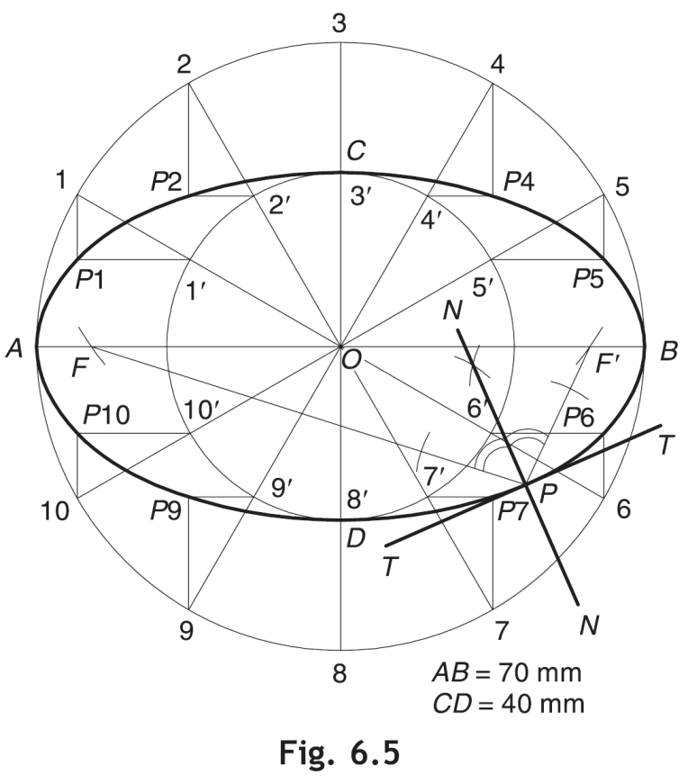
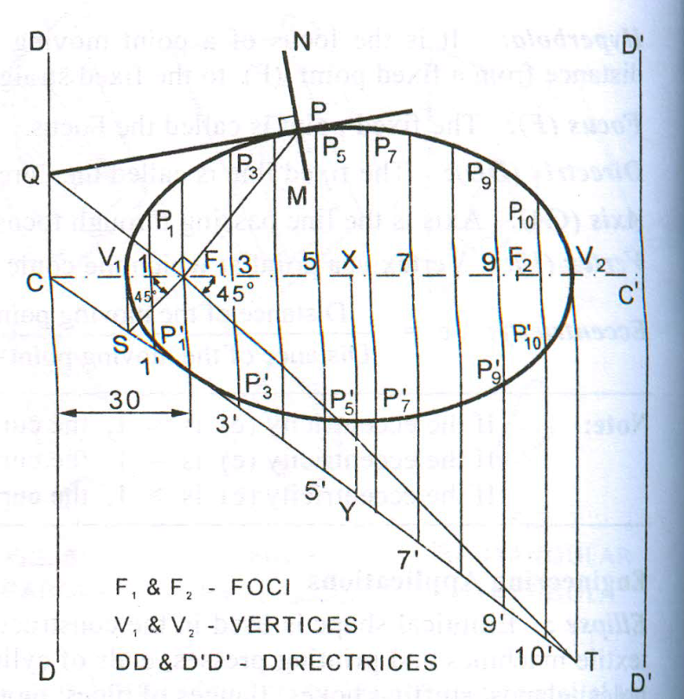
Draw Tangent & Normal to Ellipse at any point on it
Bisector Method when Focus and Directrix are not known
First obtain the foci F and F′ by cutting the arcs on major axis with C as a centre and radius =OA
Obtain NN, the bisector of ∠FPF′. N-N is the required normal
Draw TT perpendicular to N-N at P. T-T is the required tangent
When Focus and Directrix are known
Mark the given point P and join PF₁ .
At F₁ draw a line perpendicular to PF₁ to cut DD at Q.
Join QP and extend it. QP is the tangent at P
Through P, draw a line NM perpendicular to QP. NM is the normal at P

Slide 15
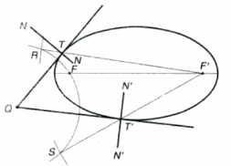
Tangent & Normal from a point outside ellipse
With Q as center and radius = QF, draw arc
With F’ as center and radius = major axis draw arc to cut previous at R & S
Join RF’ & SF’, cutting ellipse at T & T’ resp.
Join QT & QT’ to represent the required tangent. Draw N-N & N’-N’, perpendicular to QT & QT’ at T & T’ resp. for normals.

Slide 16
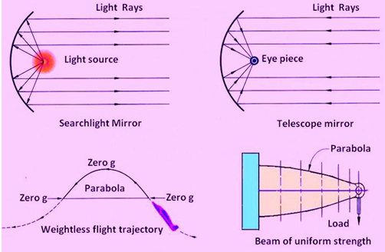
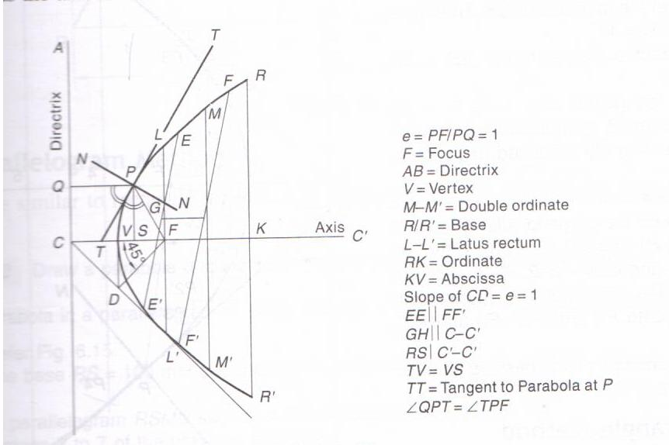
Parabola
A parabola is a conic whose eccentricity is equal to 1. It is an open-end curve with a focus, a directrix and an axis.
Terminologies

Slide 17
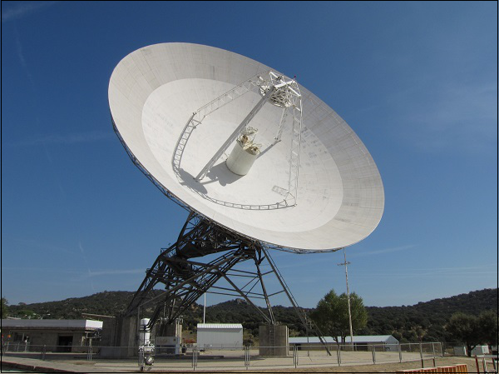
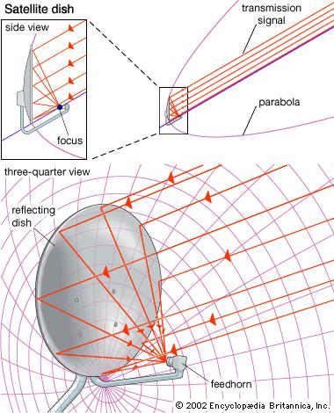
Parabolic engineering structures
https://www.tutorialspoint.com/antenna_theory/antenna_theory_parabolic_reflector.htm
https://media1.britannica.com/eb-media/82/72982-004-9191583E.jpg

Slide 18
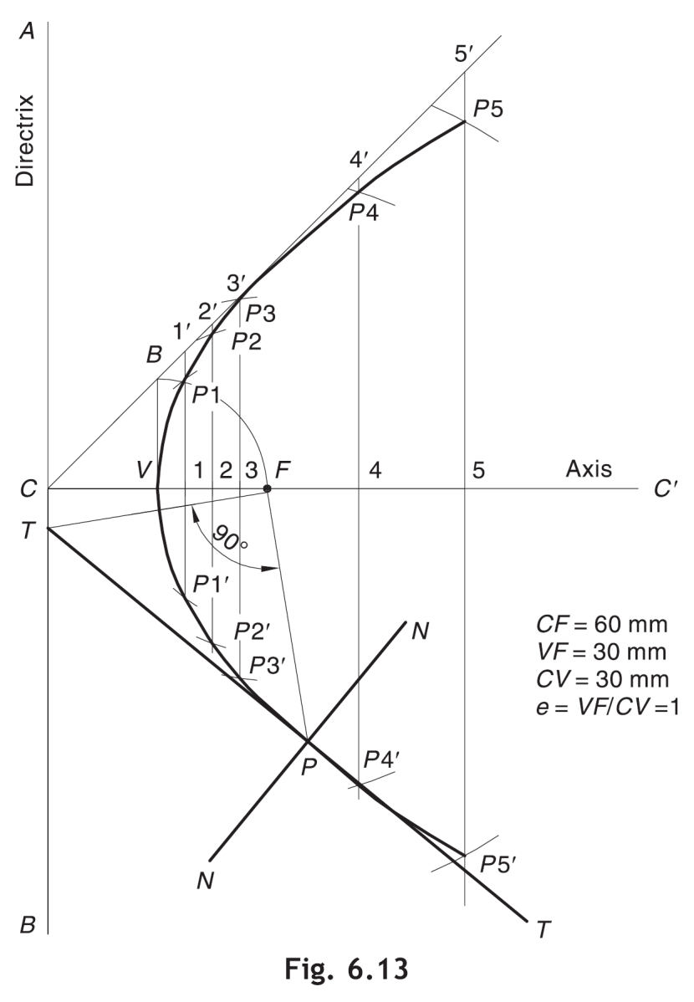
Generating a parabola
Drawing a parabola if the distance of focus from the directrix is 60 mm
Focus-Directrix Or Eccentricity Method
Draw directrix AB and axis CC’
Mark F on CC’ such that CF = 60 mm.
Mark V at the midpoint of CF. Therefore, e = VF/ VC = 1.
At V, erect a perpendicular VB = VF. Join CB.
Mark a few points, say, 1, 2, 3, … on VC’ and erect perpendiculars through them meeting CB produced at 1’, 2’, 3’, …
With F as a centre and radius = 1–1’, cut two arcs on the perpendicular through 1 to locate P1 and P1’. Similarly, with F as a centre and radii = 2–2’, 3–3’, etc., cut arcs on the corresponding perpendiculars to locate P2 and P2’, P3 and P3’, etc.
Draw a smooth curve passing through V, P1, P2, P3 … P3

Slide 19
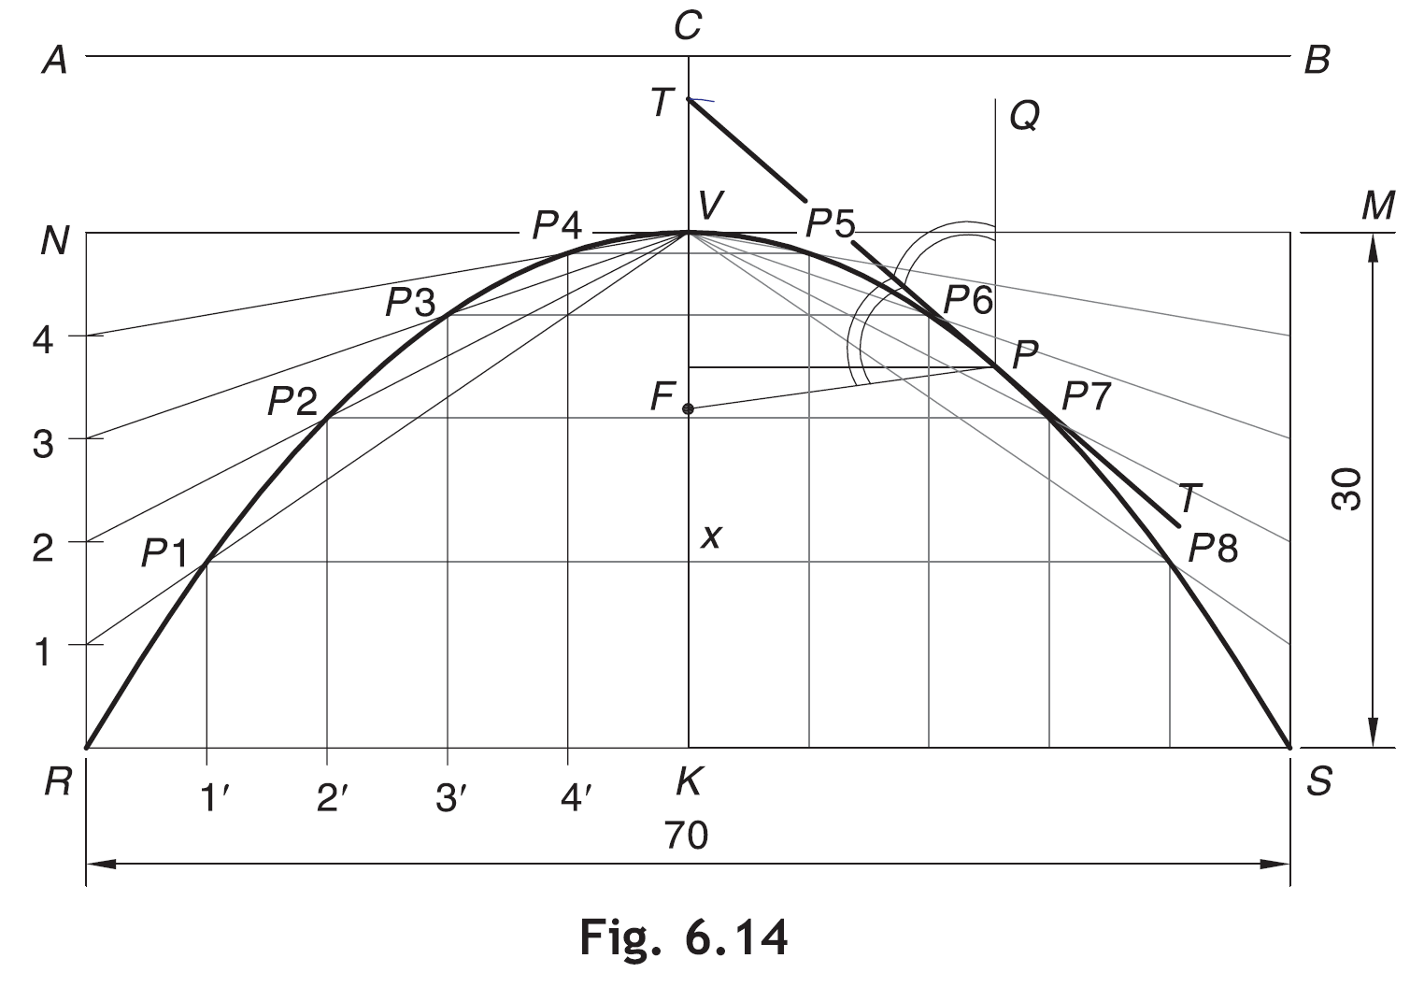
Generating parabola (Rectangle method)
Draw a parabola having an abscissa of 30 mm & the double ordinate of 70 mm.
Draw the double ordinate RS = 70 mm. At midpoint K erect a perpendicular KV = 30 mm to represent the abscissa.
Construct a rectangle RSMN such that SM = KV.
Divide RN and RK into the same number of equal parts, say 5. Number the divisions
6
6
5
5
4
4
3
3
2
2
1
as 1, 2, 3, 4 and 1’, 2’, 3’, 4’, starting from R.
4. Join V–1, V–2, V–3 and V–4.
Through 1’, 2’, 3’ and 4’, draw lines parallel to KV to meet V–1 at P1, V–2 at P2, V–3 at P3 and V–4 at P4, respectively.
Obtain P5, P6, P7 and P8 in the other half of the rectangle in a similar way.
Join P1, P2, P3 … P8 to obtain the parabola.
1
1
2
3
4
5
6
5
4
3
2
1

Slide 20
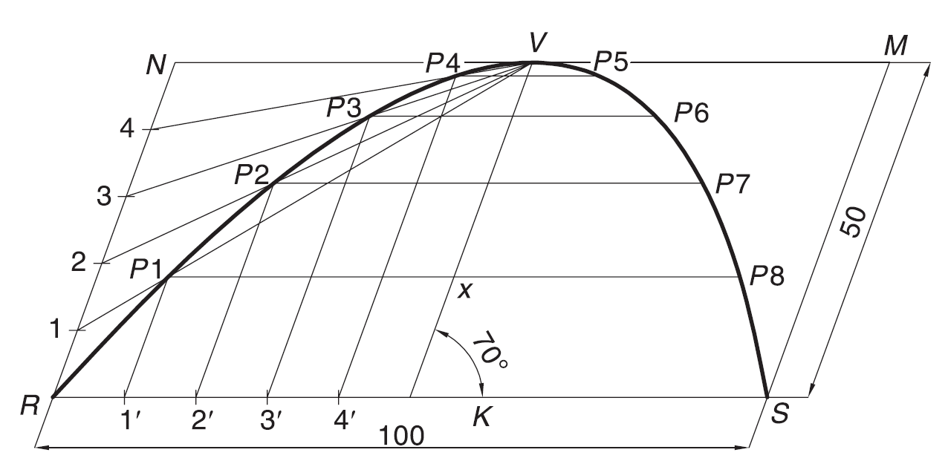
Generating parabola (Parallelogram method)
Draw a parabola of base 100 mm and axis 50 mm if the axis makes 70° to the base.
Draw the base RS = 100 mm and through its midpoint K, draw the axis KV = 50 mm, inclined at 70° to RS.
Draw a parallelogram RSMN such that SM is parallel and equal to KV.
Follow steps as in rectangle method

Slide 21
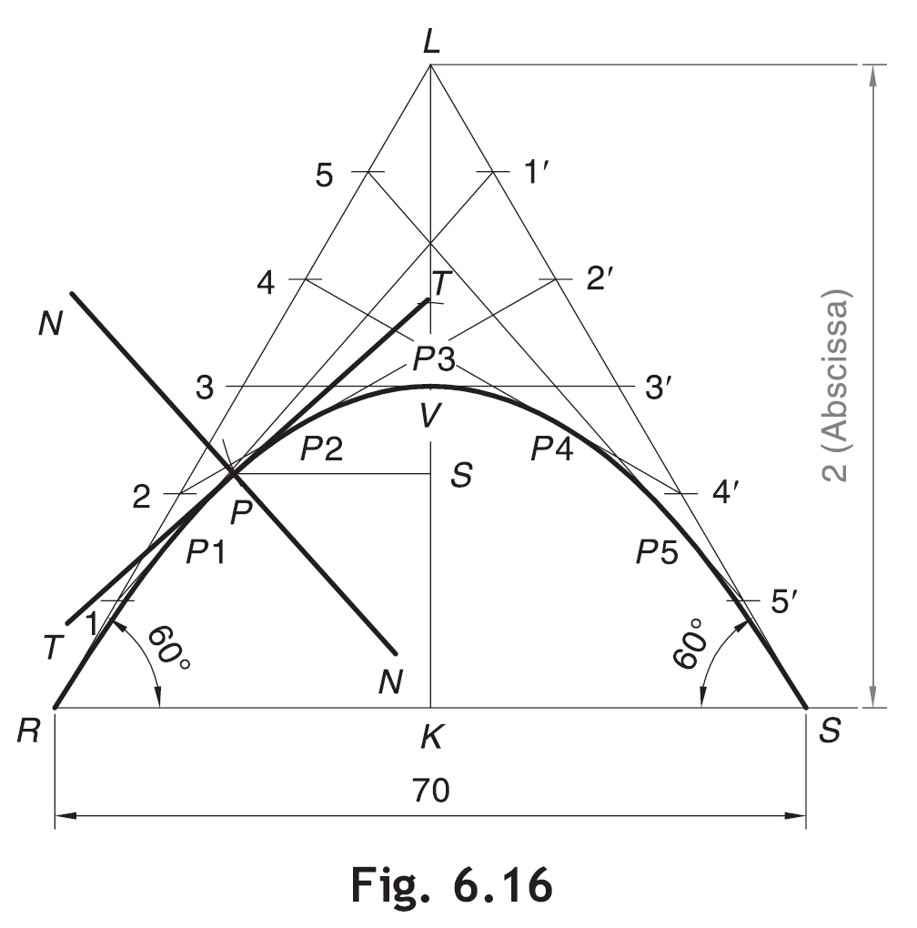
Generating parabola (Tangent method)
Draw a parabola if the base is 70 mm and the tangents at the base ends make 60° to the base.
Draw the base RS = 70 mm. Through R and S, draw the lines at 60° to the base, meeting at L.
Divide RL and SL into the same number of equal parts, say 6. Number the divisions as 1, 2, 3 … and 1’, 2’, 3’, … as shown.
Join 1–1’, 2–2’, 3–3’, ….
Draw a smooth curve, starting from R and ending at S and tangent to 1–1’, 2–2’, 3–3’, etc., at P1, P2, P3, etc., respectively

Slide 22
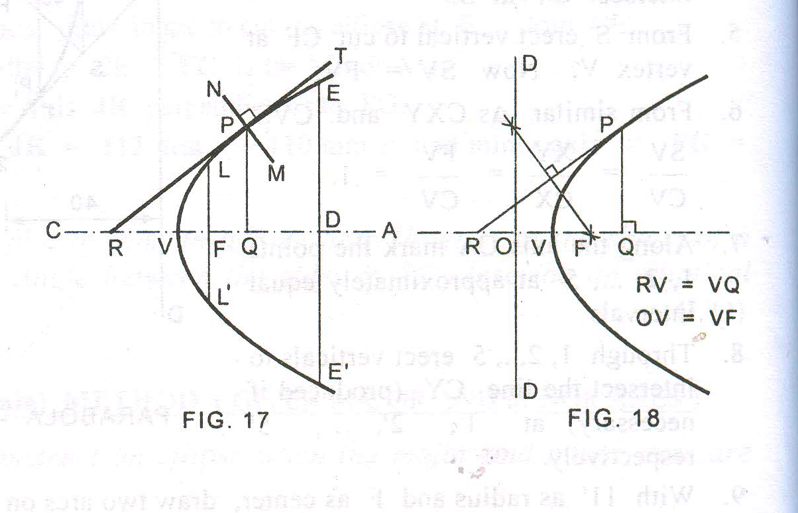
Tangent and Normal at any point P when Focus and Directrix are not known
Draw the ordinate PQ
Find the abscissa VQ
Mark R on CA such that RV=VQ
Draw the normal NM perpendicular to RP at P
To find the focus and the directrix of a parabola given its axis
Mark any point P on the parabola
Draw a perpendicular PQ to the given axis
Mark a point R on the axis such that RV=VQ
Focus: Join RP. Draw a perpendicular bisector of RP cutting the axis at F, F is the focus
Directrix: Mark O on the axis such that OV= VF. Through O draw the directrix DD perpendicular to the axis

Slide 23
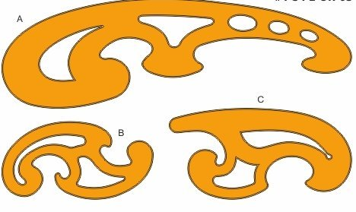
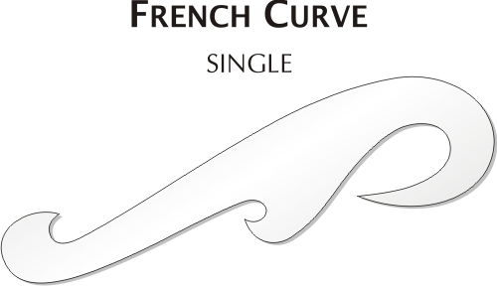
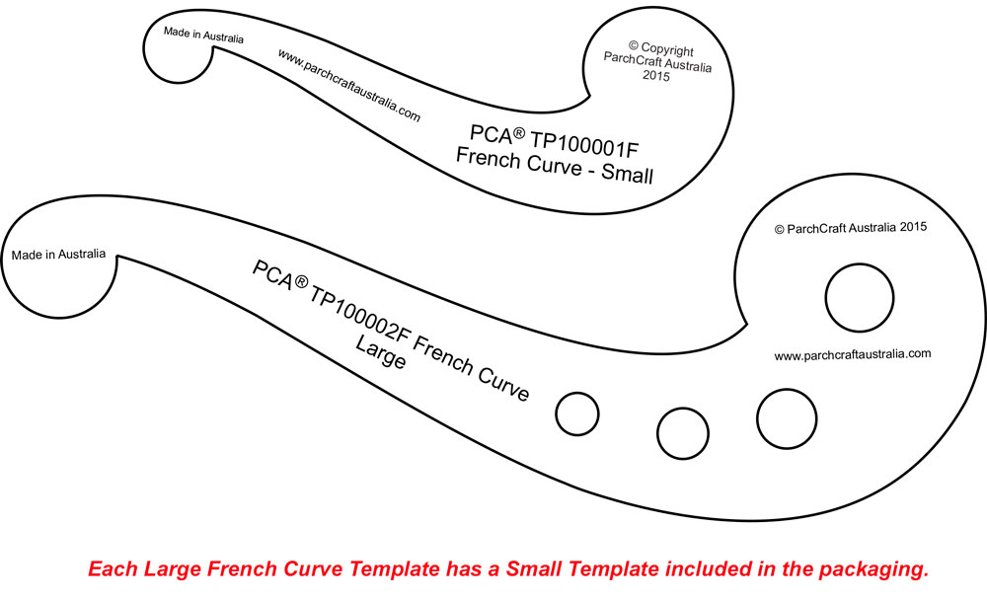
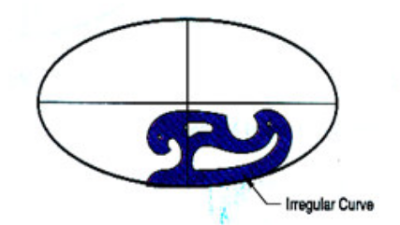
FRENCH CURVES

Slide 24
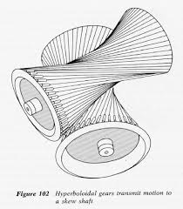
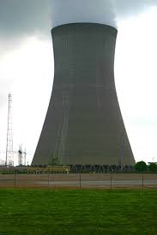
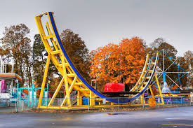
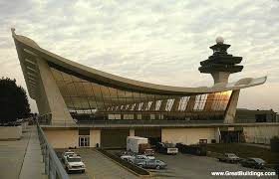
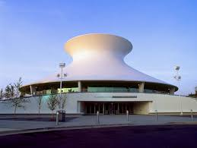
APPLICATIONS OF HYPERBOLA

Slide 25
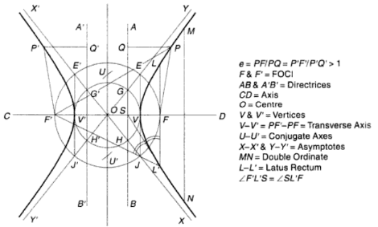
Hyperbola
It is defined as a curve traced by the point moving in a plane such that the difference between its distance from 2 fixed points in the same plane is always the same. The fixed points represent the foci.
The hyperbolas exist in a pair.
Terminology
Application
Cooling towers
Hyperbolic mirrors in telescopes
Notes:
Draw a circle with O as centre and radius OF. Draw perpendicular to (V V′) at V and V′ cutting the circle at E′, J. The diagonals E, J′ are the asymptotes

Slide 26
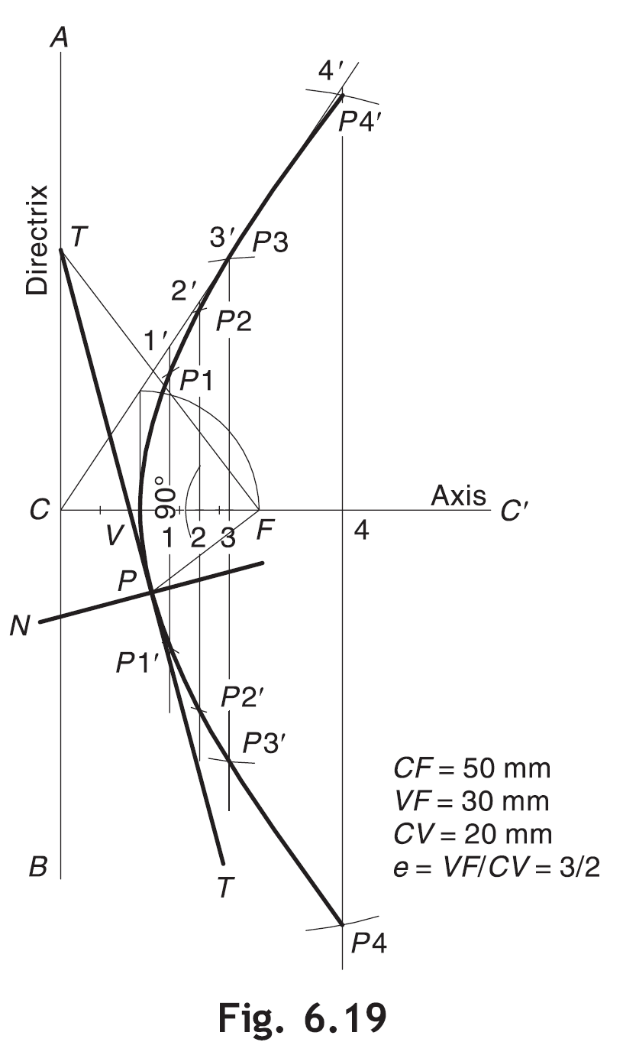
Generating hyperbola (Focus directrix or
eccentricity method)
Draw a hyperbola of e = 3/2 if the distance of the focus from the directrix = 50 mm.
Draw directrix AB and axis CC’ as shown.
Mark F on CC’ such that CF = 50 mm.
Divide CF in to 3 + 2 = 5 equal parts and mark V at second division from C. Now, e = VF/ VC = 3/2.
Follow steps as in ellipse and parabola

Slide 27
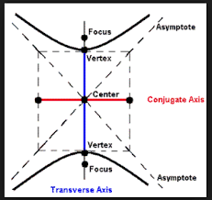
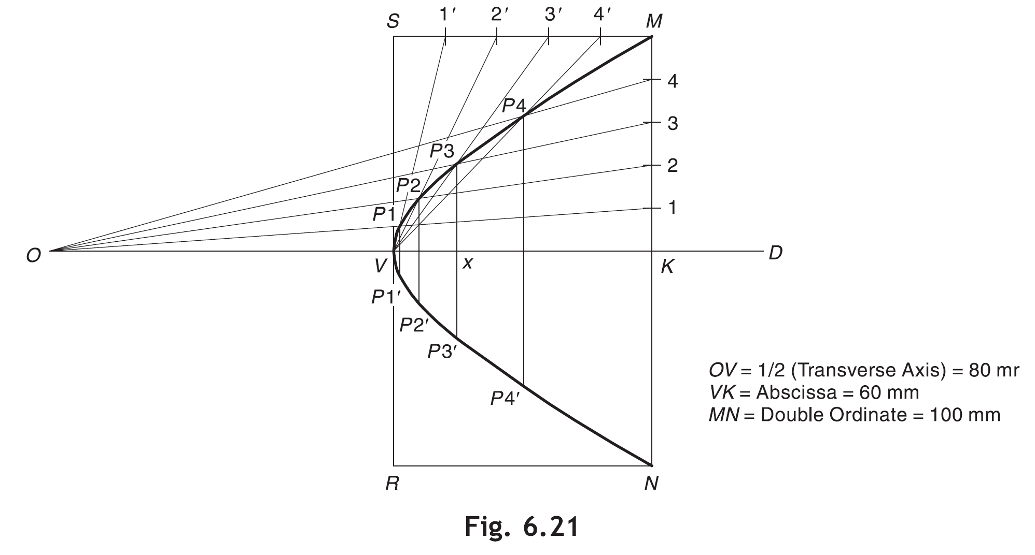
Generating hyperbola (rectangle or
Abscissa- ordinate method)
Draw a hyperbola having the double ordinate of 100 mm, the abscissa of 60 mm and the transverse axis of 160 mm.
Draw axis OD and mark V and K on it such that OV = 1/2(Transverse Axis) = 80 mm and VK =Abscissa = 60 mm.
Through K, draw double ordinate MN = 100 mm.
Construct rectangle MNRS such that NR = VK.
Divide MK and MS into the same number of equal parts, say 5. Number the divisions as shown.
5. Join O–1, O–2, O–3, etc. Also join V–1’, V–2’, V–3’, etc. Mark P1, P2, P3, etc., at the intersections of O–1 and V–1’, O–2 and V–2’, O–3 and V–3’, etc., respectively.
6. Obtain P1’, P2’, P3’, etc., in other half in a similar way. Alternatively, draw P1/ P1’, P2/P2’, P3/P3’, etc., such that P3 –x = x–P3’ and likewise.

Slide 28
Cycloidal
E.g. cycloidal gear tooth profiles
A cycloid is a curve generated by a point on the circumference of a circle rolling along a straight line without slipping. The rolling circle is called a generating circle and the straight line is called a directing line or base line. The point on the generating circle which traces the curve is called the generating point.
The cycloid is called the epicycloid when the generating circle rolls along another circle outside it & hypocycloid when it rolls along another circle inside it.
The other circle along which the generating circle rolls is called the directing circle or the base circle.

Slide 29
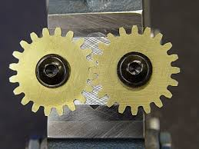
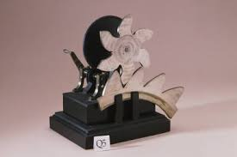
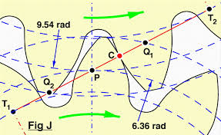
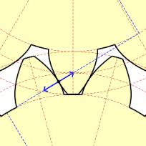

Slide 30
Generating cycloid
4
p₄
3
5
p₃
p₅
C
p₂
p₆
C₁ C₂ C₃ C₄ C₅ C₆ C₇ C₈
2
6
p₁
1
7
p₇
P
πD
p₈
Draw locus of a point on the periphery of a circle which rolls on straight line path. Take circle diameter as 50 mm
1) From center C draw a horizontal line equal to πD distance.
2) Divide πD distance into 8 number of equal parts and name them C1, C2, C3__ etc.
3) Divide the circle into 8 number of equal parts in clock wise direction, after P name 1, 2, 3..,8.
4) From all these points on circle draw horizontal lines. (parallel to locus of C)
5) With a fixed distance C-P in compass, C1 as center, mark a point on horizontal line from 1. Name it P1.
6) Repeat this procedure from C2, C3, C4 upto C8 as centers. Mark points P2, P3, P4, P5 up to P8 on the horizontal lines drawn from 2, 3, 4, 5, 6, 7 respectively.
7) Join all these points by curve. It is Cycloid.

Slide 31
Draw locus of a point on the periphery of a circle which rolls on a curved path.
Take diameter of rolling Circle 50 mm And radius of directing circle as 75 mm.
1) When smaller circle rolls on larger circle for one revolution it covers ΠD distance on arc & it will be decided by included arc angle θ.
2) Calculateθ = (r/R) x 360°.
3) Construct angle θ with radius OC and draw an arc by taking O as center OC as radius
Generating/
Rolling Circle
4
5
C₁
C₂
C₃
C₄
3
6
C
C₅
7
C₆
2
r = CP
1
P
C₇
Directing Circle
R
C₈
r
+
=
360⁰
O
R
4) Divide this sector into 8 equal angular parts. And from C onward name them C1, C2, C3 up to C8.
5) Divide smaller circle (Generating circle) in 8 number of equal parts. And next to P in clockwise direction name those 1, 2, 3, up to 8.
6) With O as center, O-1 as radius draw an arc in the sector. Take O-2, O-3, O-4, O-5 up to O-8 distances with center O, draw all concentric arcs in sector. Take fixed distance C-P in compass, C1 center, cut arc of 1 at P1.
Repeat procedure tolocate P2, P3, P4, P5… P8 to join them by epicycloid curve.

Slide 32
Draw locus of a point on the periphery of a circle which rolls from the inside of a curved path. Take diameter of rolling circle 50 mm and radius of directing circle (curved path) 75 mm.
Solution Steps:
1) Smaller circle is rolling here, inside the larger circle. It has to rotate anti-clockwise to move ahead.
2) Same steps should be taken as in case of EPI – CYCLOID. Only change is in numbering direction of 8 number of equal parts on the smaller circle.
3) From next to P in clockwise direction, name 1,2,3,4,5,6,7,8.
4) Further all steps are that of epi – cycloid.
P
1
HYPO CYCLOID
P₁
2
7
P₂
C₁
C₂
C₃
C
C₄
P₃
3
C₅
6
C₆
5
4
P₄
C₇
P₅
P₈
P₆
P₇
C₈
r
=
+
360⁰
R
O
OC = R ( Radius of Directing Circle)
CP = r (Radius of Generating Circle)

Slide 33
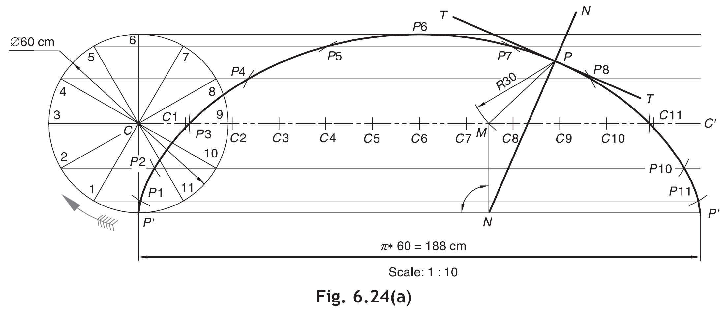
Tangent and Normal to Cycloid
With P as a centre and radius = CP’ (i.e., radius of generating circle), cut an arc on C–C” at M.
From M, draw a normal MN to P’ –P”. In case of epicycloid and hypocycloid, this can be done by joining MO and then locating N at the intersection of P’ –P” and MO (produced it necessary).
Join NP for the required normal. Draw tangent T–T perpendicular to NP at P.

